Slide 1
Traversing a List #3
A supplemental lesson for AP CSP

Slide 2
Warm-up
Review:
Creating and accessing a list
Traversing a list
Using a for loop

Slide 3
Traversing a list
Traversing means to travel, or traverse, through a list one element at a time in order.
To traverse a list you use a for loop to:
Start with the first index (0) and access that item.
Continue accessing each item in order until the last index (length of list - 1) is reached.
This technique is sequencing.

Slide 4
Traversing a list
Traversing a list can be very useful in many ways, such as:
Display all items in a list, one at a time, like a slideshow.
Looking through a list to see if a particular value is an item in the list.
Create a sub-list from the complete list, like all numbers less than 10.
The first two lessons focused on displaying or using all items in a list, one at a time.
This lesson will focus on the second and third ways that traversing a list is useful.

Slide 5
Traversing a List: Example #6
This program will traverse a list to see if a particular value is an item in the list.
In CodeSpace, go to the sandbox.
Go to File → New File … and create a file named Class_Schedule

Slide 6

Traversing a List: Example #6
This program will let the user input a class, and see if it is in a student’s schedule.
Import the codex module.
Create a list that could be a student schedule.
  Your schedule should be your actual class schedule.

Slide 7

Traversing a List: Example #6
You can use a for loop to traverse a list and compare each item one at a time to see if it matches a specific value.
The loop would look like this:

Slide 8

Traversing a List: Example #6
However, most programming languages have a short-cut structure that builds in the for loop for traversal.
In Python, checking for a specific value in a list looks like this:
Notice it doesn’t have a for loop. It is built-in!

Slide 9
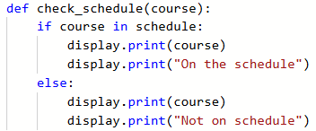
Traversing a List: Example #6
Add a function to your program that will search the list to see if the parameter “course” is in it.
Since this is an if statement, it is easy to add an “else” block as well.

Slide 10
Traversing a List: Example #6
Now add code to the main program to get the course you are checking for, and to call the function.
In previous lessons and missions you used the Console Panel to:
Test code in real time
Print data
You can also use the Console Panel to type input!
Use the input() function.

Slide 11

Traversing a List: Example #6
Complete the Main Program.
Open the Console Panel.
Run the code.
When you are prompted to enter a course, type in a class someone might take at school. Press <enter>
Check your CodeX to see if the student schedule has the class.

Slide 12
Traversing a List: Example #7
This program will create a sub-list from the complete list, like all numbers less than 10.
In CodeSpace, go to the sandbox.
Go to File → New File … and create a file named Number_Sorter

Slide 13
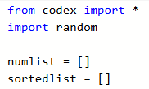
Traversing a List: Example #7
This program will generate random numbers, and then create a sub-list of numbers. It will use two lists: one for the original list of numbers, and one for the sub-list of numbers.
Import the codex module and the random module.
Create two empty lists.

Slide 14

Traversing a List: Example #7
Create a function that will fill the numlist with random numbers.
Recall from the earlier Lists lessons that you can append items to a list. Create a list of random numbers by appending them.
You can decide the range of numbers (randrange)
You can decide the amount of numbers (range)

Slide 15
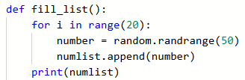

Traversing a List: Example #7
For testing, you may want to see the list that is created with random numbers.
Print it to the Console Panel.
Test the function by calling it in the Main Program.

Slide 16

Traversing a List: Example #7
Create a function that will filter the list.
Choose a number to filter by. In this example it is 20.
You want to create a sub-list of all the numbers less than your chosen number. (Could be greater than)
Traverse the list and check each number.
If it meets the condition, append it to the sorted list.

Slide 17

Traversing a List: Example #7
Test the function by calling it in the main program.
Make sure the Console Panel is open.
You can see the original number list.
But you don’t see the filtered list.
Use the CodeX to display the results.
This will be another function.

Slide 18
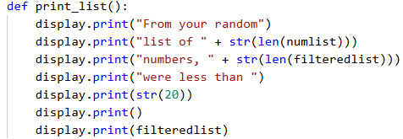
Traversing a List: Example #7
Create a function for printing the results.
It could look similar to this.
Remember, to print an integer you need to convert it to a string data type using the str() function.
Call the function in the main program.
Run the program.

Slide 19

Traversing a List: Example #7
This program has data abstraction with the two lists, but it could use some procedural abstraction as well.
The functions use the same numbers every time.
Use variables for the range of numbers, the range in the for loop, and the number to filter by.
You can get values for these variables using input().

Slide 20

Traversing a List: Example #7
Your variable names and prompts could look like this.
The values from an input() statement are strings.
You need the answers to be integers.
Use the int() function to convert the strings to integers.
Modify your functions to use parameters.
Try doing this part on your own.

Slide 21
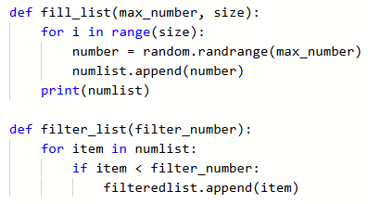
Traversing a List: Example #7
Your functions should look similar to:

Slide 22
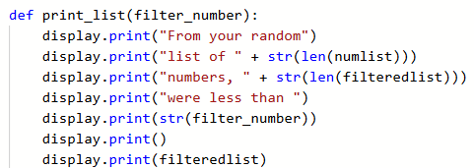
Traversing a List: Example #7
Did you remember to add a parameter to the print_list() function?
Lists are global and do not need to be parameters.
Modify the function calls to use arguments.
Try doing this part on your own.

Slide 23
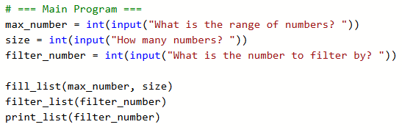
Traversing a List: Example #7
Test your program by running it several times, and check the results.
This program doesn’t really have a purpose, but it does show how to traverse a list to filter it.

Slide 24
Traversing a List: Example #8
This program will traverse a list to see if a particular value is an item in the list AND create a filtered list from the complete list.
Let’s write a program that does both
In CodeSpace, go to the sandbox.
Go to File → New File … and create a file named Animal_Sorter

Slide 25
Traversing a List: Example #8
This program will use three lists.
You will create the first list by making a list of a category of animals.
This example uses farm animals, but you can use a different group if you want.

Slide 26
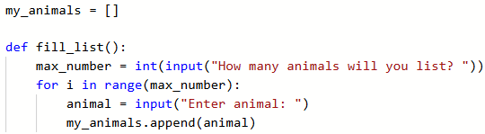
Traversing a List: Example #8
The second list will start empty
Create a function that asks the user to enter animals on the Console Panel to fill the list.
You are using animals, which are strings, so you don’t need to convert to integers.

Slide 27
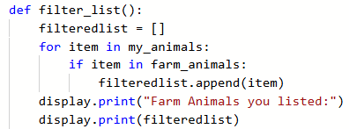
Traversing a List: Example #8
Create a function to filter the list.
The function will traverse the second list.
It will check each item in the second list to see if it is in the first list.

Slide 28

Traversing a List: Example #8
Call the functions in the Main Program.
Run the code several times for testing.
Your program and functions don’t all need to look the same.
There are many different ways to accomplish the same task!

Slide 29
Traversing a List Summary
You now have several ways to traverse a list in a CodeX program:
Traverse a single list using a specialized for loop.
Traverse multiple lists using a for loop and index.
Repeatedly traverse a list using a for loop.
Traverse a list by checking if a value is in a list.
Traverse a list to filter it.

Slide 30
Wrap Up
Maybe the most important thing to remember is that each program is different, and each programmer is different. There are many ways to write a program to complete a task.
Sometimes a function needs a parameter, and sometimes it doesn’t. They can be written differently and still accomplish the same task.
Variable and function names can be different, but should always be descriptive.
You can use the Console Panel to give input as well as receive output.

Slide 31
Wrap Up
You now have several reasons to traverse a list.
Can you discuss some reasons?
Submit the completed programs to your teacher.
Complete the wrap-up questions in the activity guide.

